Slide 1

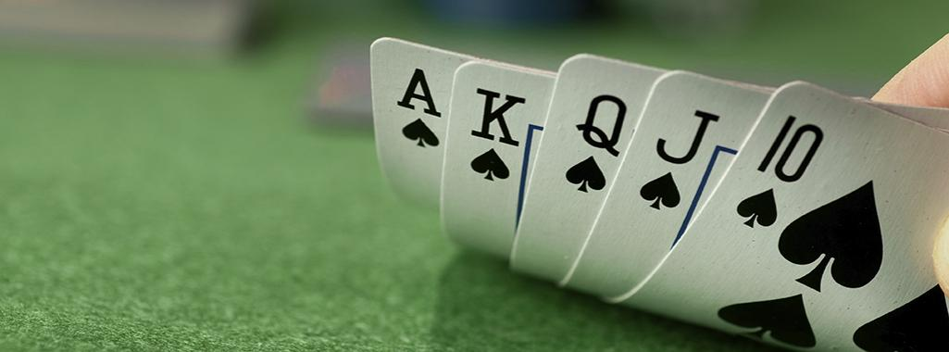
Poker Prediction using Machine Learning
Arish Balasubramani (304455611)
Cheryl Maria Jose (305052753)
Prasanth Kannan (305059149)
Prasanth Reddy Yerradoddi (304387751)
Rajaputhri Maharaja (305059344)

Slide 2
INTRODUCTION:
Poker is a family of gambling card games, but is often considered a skill based game.
All poker players involved determine the winner of each hand according to the combinations of players' cards.
All the poker players involved will be given with 2 cards each and there will be 5 cards on the table.
From among the 5 cards each player will choose 3 best cards such that the 2 in their hand and the best of 3 they choose from 5 forms a best hand(from 0 to 9).
Which ever player has the highest hand from 0 to 9 will be the winner.

Slide 3
ABSTRACT:
In this poker project, we will be predicting the outcome of the poker hand.
Machine learning algorithm will learn the poker rules based on the training dataset.
We take each row from the training set which has 5 random cards (Rank and suits).
Based on the ranks and suits of the 5 random cards, the machine learning algorithm will find out under which hand categories it falls into.

Slide 4
Classifications of Hands:
0: Nothing in hand; not a recognized poker hand
1: One pair; one pair of equal ranks within five cards
2: Two pairs; two pairs of equal ranks within five cards
3: Three of a kind; three equal ranks within five cards
4: Straight; five cards, sequentially ranked with no gaps
5: Flush; five cards with the same suit
6: Full house; pair + different rank three of a kind
7: Four of a kind; four equal ranks within five cards
8: Straight flush; straight + flush
9: Royal flush; {Ace, King, Queen, Jack, Ten} + flush

Slide 5

Video for explanation of poker hands:

Slide 6
IMPLEMENTATION:
Training and testing dataset:
The training dataset has totally 10 features and a label.
S1, s2, s3, s4 and s5 (5 suits)
c1, c2, c3, c4 and c5 (5 cards)
Label (hand)
Training: 25010 Datasets
Testing: 1 Million Dataset
Testing dataset has no label.
S1 | C1 | S2 | C2 | S3 | C3 | S4 | C4 | S5 | C5 | hand
4 | 9 | 2 | 1 | 2 | 2 | 4 | 7 | 2 | 8 | 0
1 | 4 | 3 | 6 | 1 | 12 | 3 | 11 | 2 | 7 | 0
1 | 11 | 4 | 1 | 3 | 7 | 4 | 11 | 2 | 1 | 2
2 | 9 | 2 | 4 | 3 | 6 | 1 | 9 | 4 | 9 | 3

Slide 7
IMPLEMENTATION:
Algorithms used and challenges faced:
Initially we tried Knn, Decision tree, logistic regression and linear regression with the given training dataset.
But we achieved approximately 49 % of accuracy.
Reason:
There are 480 possible Royal Flush hands instead of just four and the other 311,875,200 possible hands correctly.
But not everything is covered in training dataset. Hence it was difficult for the algorithms to understand the rules of poker and in turn to predict the hands.
Therefore we extracted 4 new features and trained the algorithms based on those and then we predicted the testing data set.

Slide 8
IMPLEMENTATION:
Approach:
In this project, we will be predicting the outcome of the poker hand.
From training dataset we take each row.
Find the following features for each row.
Number of same suit cards.
Highest card.
Number of same value cards.
Number of cards in sequence.
We train our algorithm by giving the above extracted features using the fit method.
Then we will be predicting the hands for the testing dataset.

Slide 9
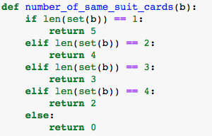
Feature 1: Number of same suit cards:
This function will find out the number of same suit (Spades, Hearts, Clubs, Diamonds) cards
Each row has exactly 5 cards, among those there can be any number of same suit cards.
To find the number of same suit cards we used the set() method in python

Slide 10

Feature 2: Highest card:
Highest card function will find the highest card among the 5 cards.
max() inbuilt function is used to find the highest card.
Ace, King, Queen, Jack are given numbers 14, 13, 12, 11 respectively

Slide 11
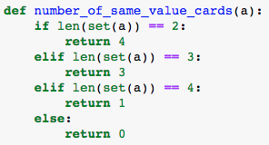
Feature 3: Number of same value cards:
This function will return the count of same numbered cards.
This function is similar to number of same suit cards.
we use set() function to find the number of same numbered cards.

Slide 12
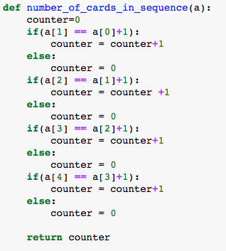
Feature 4: Number of cards in sequence:
This function will find the number of cards in sequence.
When the cards are dealt, all 5 cards will not be in order. Sorting function is used to sort the cards which makes finding the sequence cards task easier.
After the cards are sorted we compare a card to its next card to see if the cards are in sequence. We use counter variable to keep the count of cards in sequence.

Slide 13
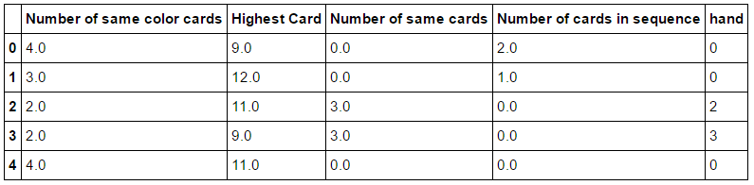
IMPLEMENTATION:
We added the corresponding Label – Hand from the training dataset to these features.
Then we used these features to train our algorithms and predict the hands for testing dataset.

Slide 14
IMPLEMENTATION:
KNN Algorithm:
We tried knn algorithm for different values of K and achieved the following results for the training dataset.
The feature table is randomly split into 60% and 40% for training and testing respectively.
Random Split
K value | Accuracy
1 | 97.03
2 | 97.62
3 | 97.24
5 | 97.23
8 | 97.07
10 | 97.02

Slide 15
IMPLEMENTATION:
K-Fold Cross Validation
We used 10 fold cross validation for KNN algorithim over the training set.
K value | Accuracy
1 | 96.91
2 | 97.56
3 | 97.25
5 | 97.14
8 | 97.07
10 | 96.96

Slide 16
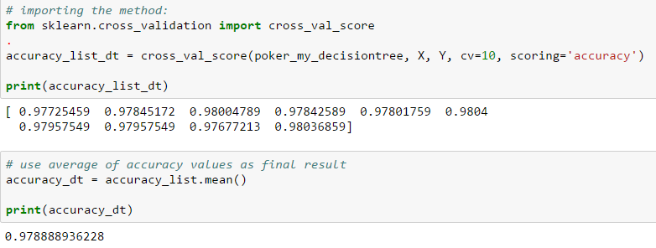
IMPLEMENTATION:
Decision tree Algorithm:
We used 10 fold cross validation for Decision tree algorithm over training set.
We achieved 97.88 % of accuracy.

Slide 17
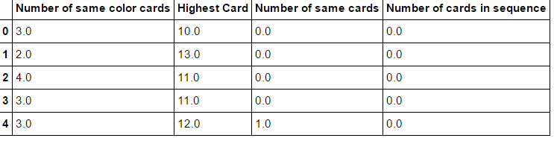

IMPLEMENTATION:
KNN Algorithm:
We extracted those 4 features for the given testing dataset
We predicted the hand for the testing dataset using the KNN algorithm

Slide 18
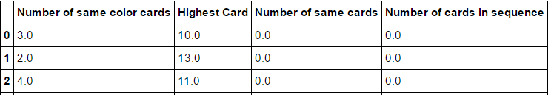
IMPLEMENTATION:
Decision tree Algorithm:
We extracted those 4 features for the given testing dataset
We predicted the hand for the testing dataset using the Decision tree algorithm

Slide 19
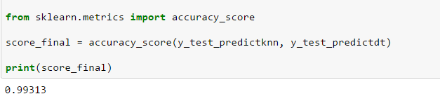
Prediction of Accuracy
Using KNN Algorithm with K=2, we were able to predict the label(hand) successfully.
Using Decision tree algorithm also we predicted the label(hand) successfully.
Finally, we calculated the accuracy between the prediction of these 2 algorithm's and we achieved 99.31% accuracy
We have also submitted the results to Kaggle in CSV file to get the actual prediction accuracy

Slide 20
Thank you !!! ☺

